Slide 1
Digital Marketing

Slide 2
Introduction to SEO
What is SEO?
Types of Search Engines
How Search Engines Work?
Understanding SERPs
SEO Approaches (White hat/Black Hat/Grey Hat)
Technical SEO, Onpage SEO & Offpage SEO
Identify your niche & audiences
Introduction to Keywords
Keywords Research (Relevancy, Searches, Competition)Low Entry Resistance

Slide 3
How much does it take for a website to rank in Google?
It depends on different factors:
Industry/niche
Target region
Domain age
SEO efforts/strategy
Usually it requires 3-6 months.

Slide 4
How do search engines work (being SEO specialist)?
Google, Yahoo, Bing ----> Seach engine crawlers/bots/spiders/robots ---> Google bot, Bingbot
Search engine crawlers crawls(read) websites ----> make a copy of pages being crawled ---> store copy in its database (datacenters)-- this process is known as “indexing/indexation”
A user searches on Google ---> Google shows results from its database
So, the sequence is:
Google ---> website crawl ---> index ---> rank

Slide 5
How do search engines work (being SEO specialist)? (Cont...)
Q: How frequently does Google crawl/index our website?
Ans: Normally it takes 3 days to four weeks. The timing depends on different factors:
1.) Website popularity/traffic --- good SEO
2.) Website updates (How frequently it is updated with anew content, page, data, etc)
This is called “Crawling fequency” and it is different for different websites and depend upon the above mentioned factors.
=> How to see when a website was crawled last time?
Ans: Write a command on browser, “cache:websiteurl.com” and you will see the date along with the tine.

Slide 6
How do search engines work (being SEO specialist)? (Cont...)
Google SERP ---> Search engine result page
Organic result --->results obtained by applying SEO
Organic traffic
Organic ranking
--> sponsored content (ads.google.com) --> for promoting websites
--> SERP Structure normally:
- Some sponsored/paid results (around 4-5 results)
-(7-10) SEO results - organic traffic
- Upto 3 more paid results

Slide 7
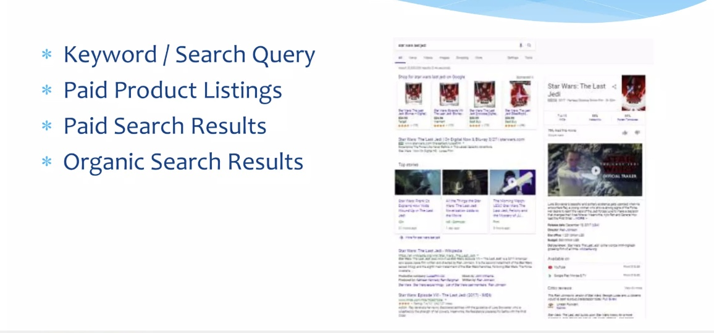
Structure of a SERP (Search Engine Result Page)

Slide 8
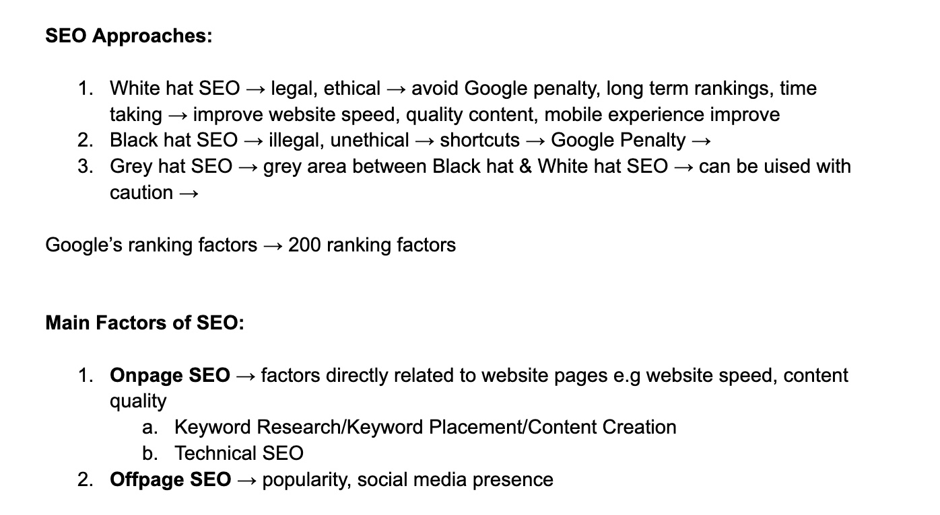

Slide 9
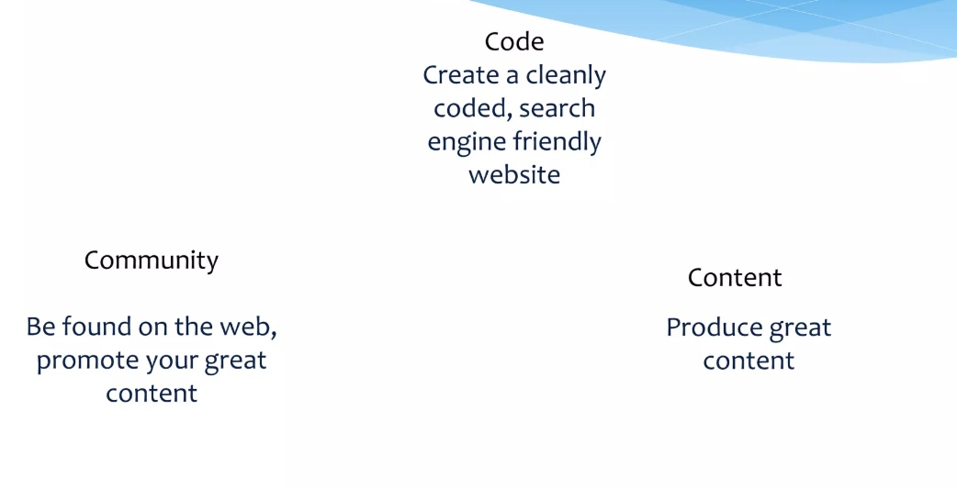
3 Keys to Higher Search Engine Rankings

Slide 10
SEO Learning Roadmap
Onpage SEO - Keyword research
Onpage SEO - Keyword placement
Onpage SEO - Content Creation
Onpage SEO - Technical SEO
Offpage SEO
Local SEO

Slide 11
On-page Optimization
Keywords Placement
Anatomy of a SEO friendly webpage
Descriptive URLs
HTML Basics for SEO (SEO related HTML Tags)
Title (keyword + USP | Brand name)
Meta Description (keywords+brand name+USP+power words)
Heading tags, h1,….h6
H1 (should be only one on one webpage)
Bold Keywords
Contextual Internal Linking (user experience, search engines)
Image Alt Tags
Notes:
Unique Selling Proposition

Slide 12
Keywords
Primary Keywords vs Secondary keywords
Long Tail Keywords Vs Short Tail Keywords
Keyword Clustering or Grouping of closely related keywords for every webpage
Analyzing competitor websites for Keywords

Slide 13
Keyword Research
Ecommerce site
Services website
Blogging
For example we look for services first
1.) Services --> Food delivery
Website name is --> yummyfood.pk
Target region --> karachi, lahore, islamabad
Page 1 --> yummyfood.pk/karachi/
Now i want to rannk this page in Google? What should be the keywords for this page?
Keywords ---> search queries related to our pages on which we want to rank.

Slide 14
Keyword Research (Cont...)
Keywords ---> search queries related to our pages on which we want to rank.
Keywords could be: (Our guess)
food delivery in karachi (yes)
fast food delivery in karachi (yes)
order food in karachi (yes)
Quality food delivery karachi (yes)
restaurant near karachi ? (NO) -- WHY
But which one is the best ? On which basis should we select the keyword?
In Digital markting, we don’t guess, wecheck numbers.

Slide 15
SEO Keyword Research Tools
1.) Ahrefs/SEMrush ---> paid tools
2.) Chatgpt for guessing keywords
Q: How to use SEMrush for keyword research?
Go on SEMrush tool on your browser --> Keyword overview --->Enter your keywords
Keyword Selection Criteria:
Volume --> how many times this keyword is being searched (montly search volume)-- e.g its its 480 then it means if this keyword is ranked, then the no. of people on this score who can come to your website is around 400-420
--> Higher the search volume, more is the traffic

Slide 16
SEO Keyword Research Tools
Keyword Selection Criteria:
Volume --> how many times this keywordis searched (montly search volume)-- e.g its its 480 then it means if this keyword is ranbked, then the no of people on this score who can come to your website is around 400-420
--> Higher the search volume, more is the traffic
--> KD --> Keyword Difficulty - It means how difficult it is to rank on that keyword
--> If the keyword difficulty is between 0-20, then it means it is very easy to rank on that keyword (less difficulty means less competition)
KD ---> (0-20) ---> Very easy to rank
KD ---> (20-35) ---> Easy to rank
KD ---> (35-45) ---> Hard to rank
KD ---> (45-60) ---> Very hard to rank
KD ---> < 60 ---> Don’t go for such keyword
CPC - Cost per click - not related to SEO (This is something that comes in Gogle Ads module)
Intent - What is intent ?

Slide 17
SEO Keyword Research Tools
Intent - What is intent ?
1.) C and T - type ---> It means commerical/transitional intent - the intent is buying - e.g for jewellery store (buy jewellery)
1.) I type ---> It mean information --> keywords are like “how to make jewellery etc, how to clean jewellery at home, etc”
Question: One should rank their jewellery store website on commerical keywords or informational keywords?

Slide 18
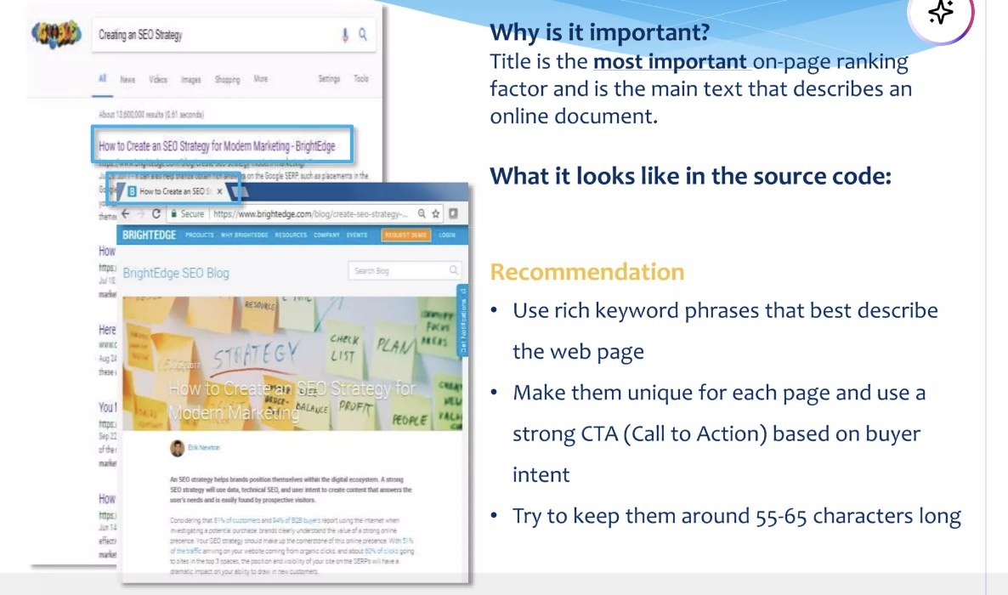
Title Tags

Slide 19
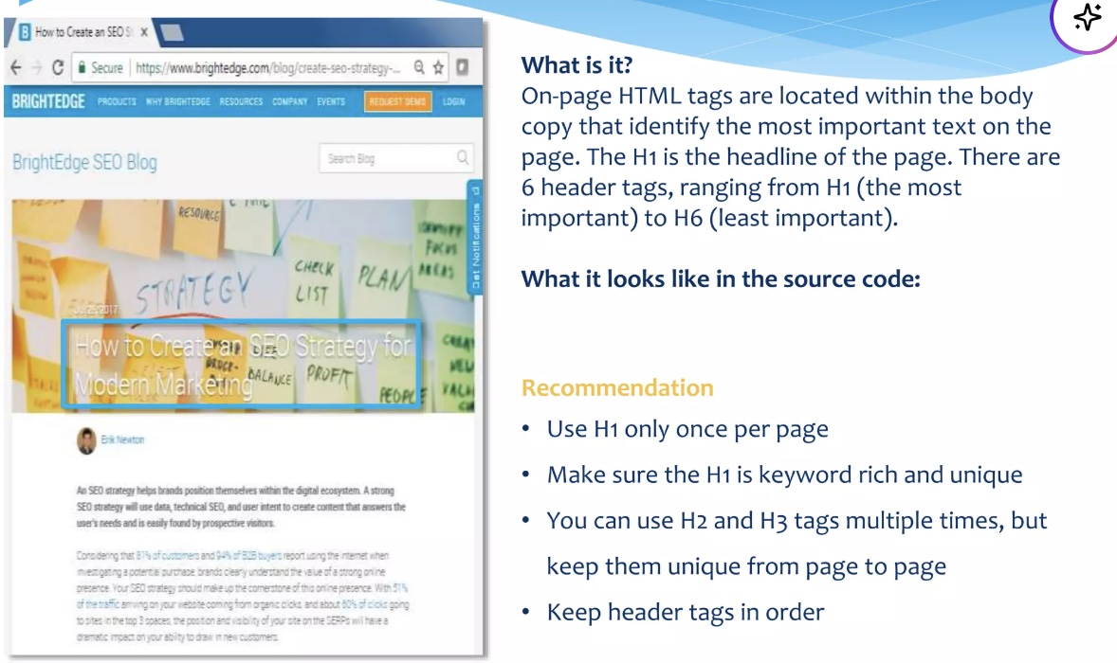
Tags

Slide 20
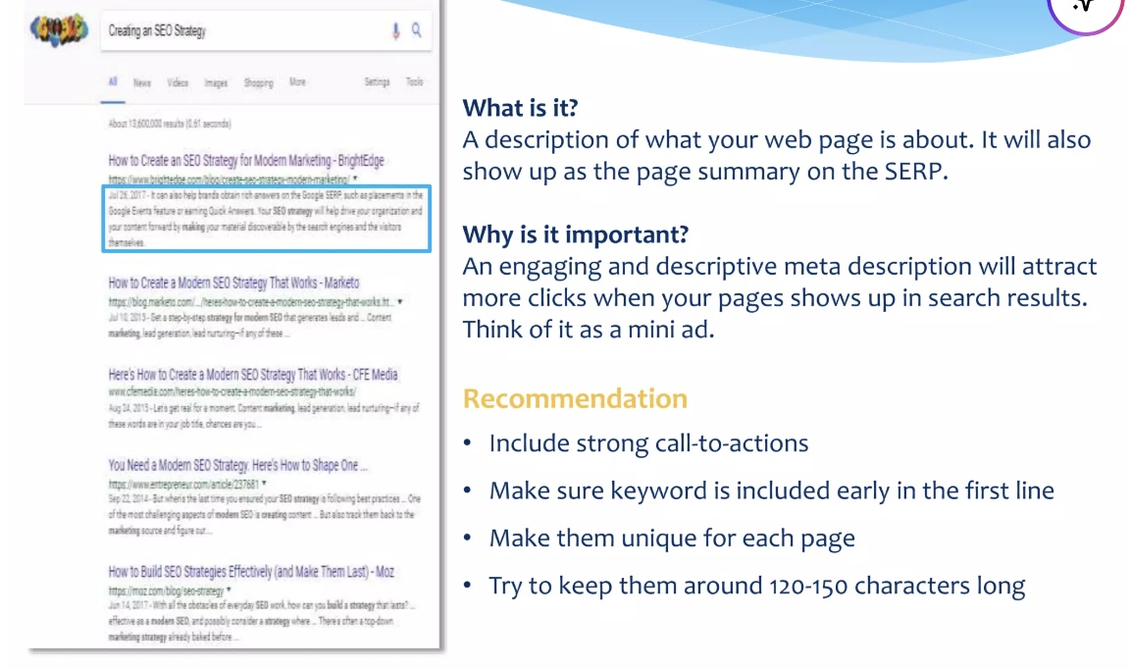
Meta Description

Slide 21
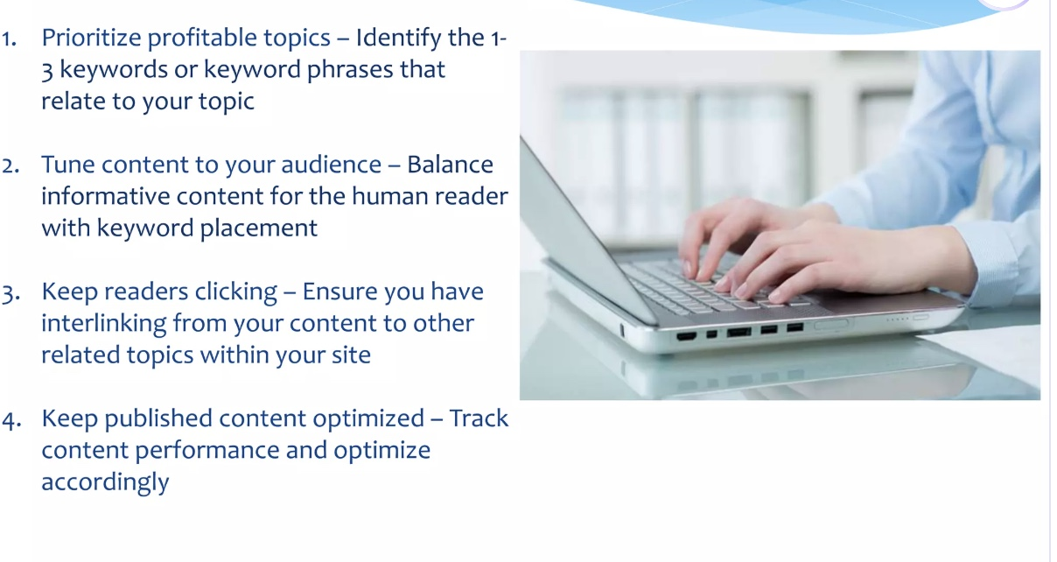
Creating Engaging Content

Slide 22
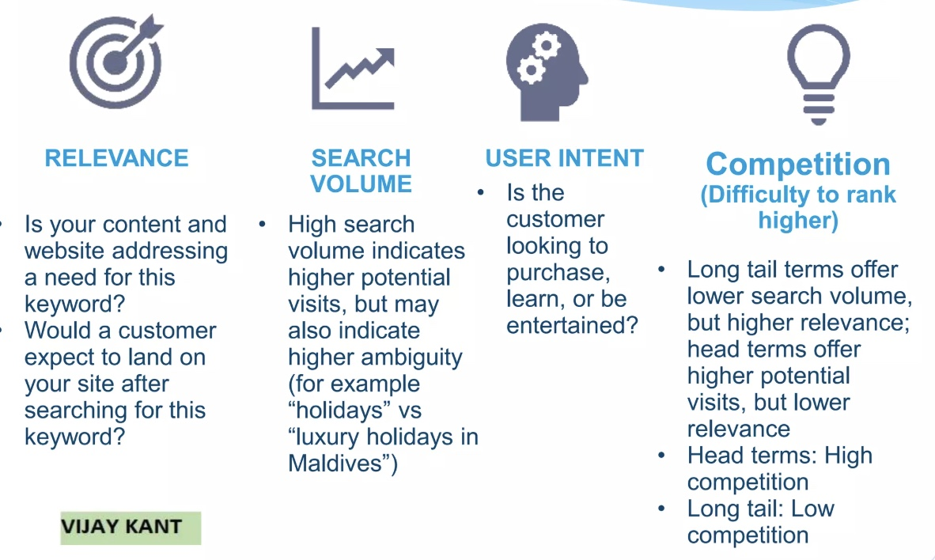
Content - Keyword Research Factors

Slide 23
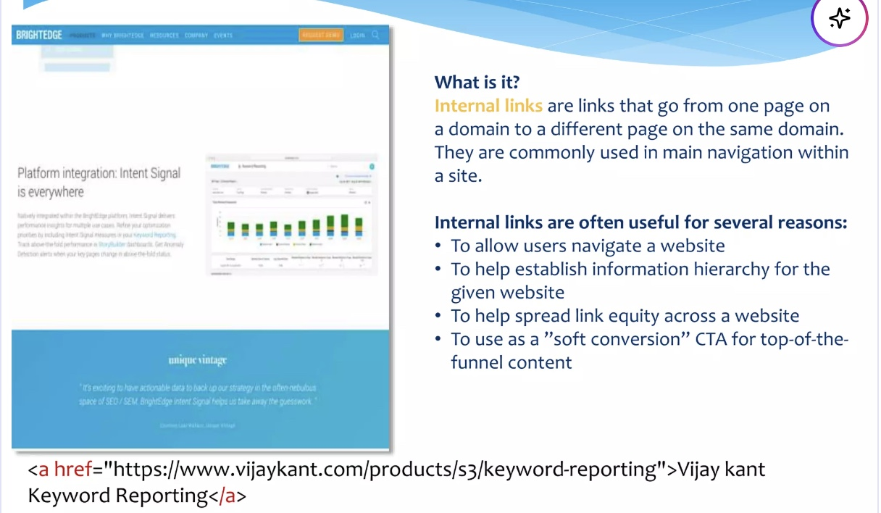
Content - Internal Links

Slide 24
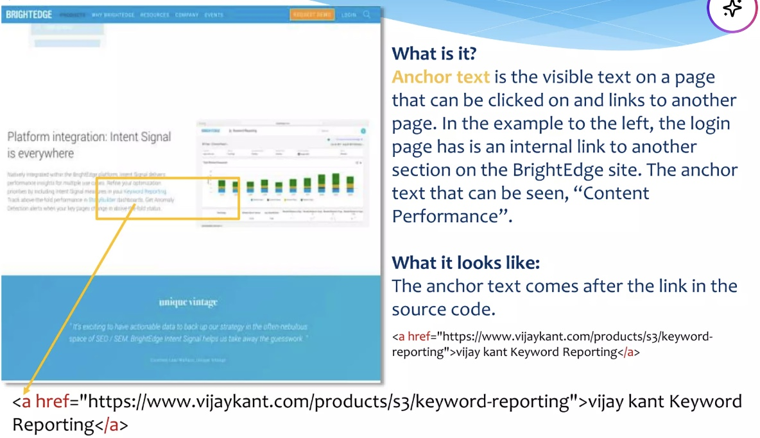
Content - Anchor Text

Slide 25
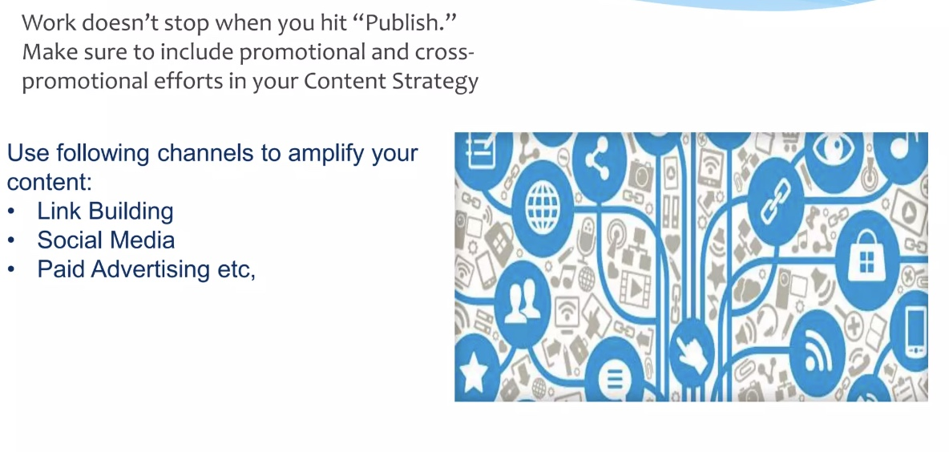
Promote Your Good Content

Slide 26
End of Lecture

